Slide 1
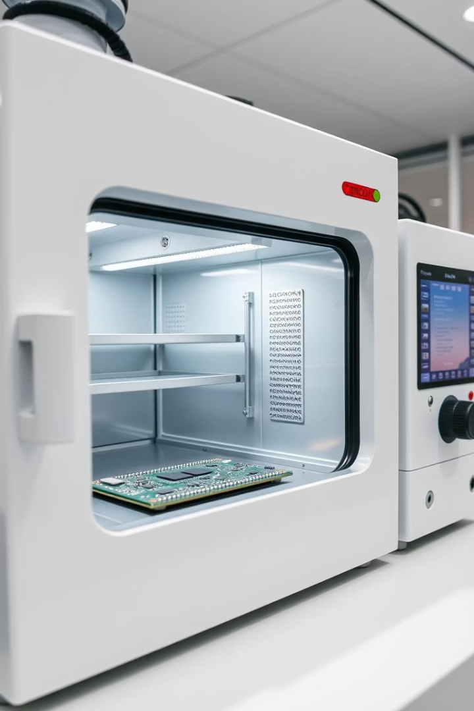
Solder Reflow Oven Using PIC18F4550
By Ahmad Mujtba & Hamza Saleem Barg
Ghulam Ishaq Khan Institute of Engineering Sciences and Technology

Slide 2
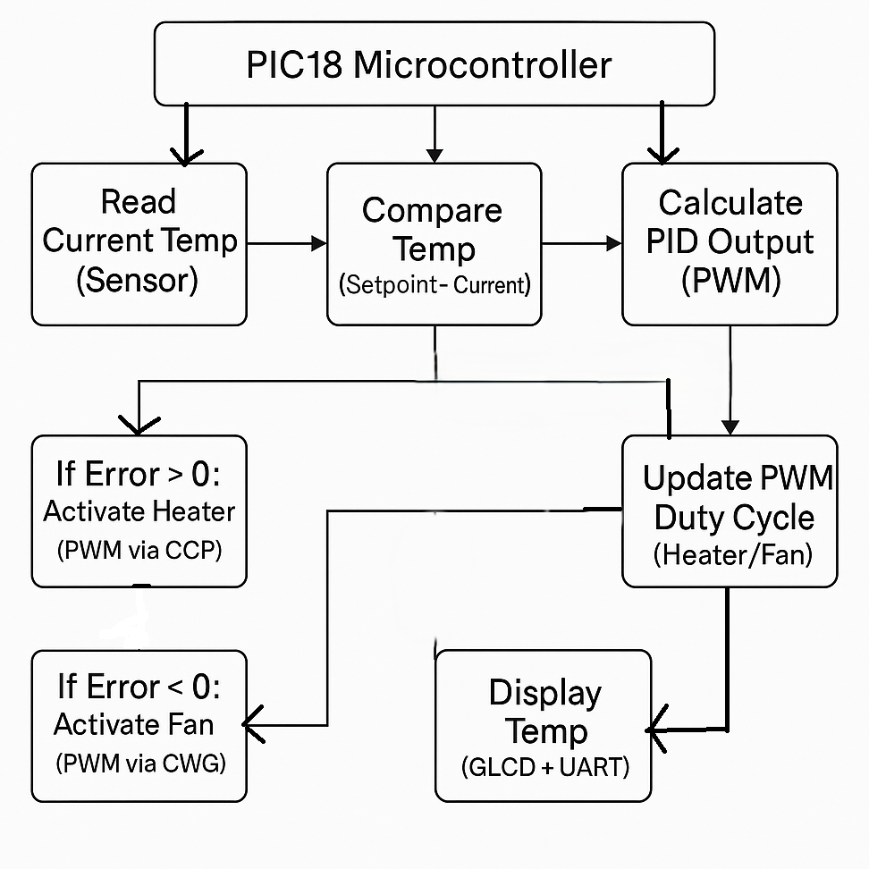
System Block Diagram
Microcontroller
PIC18F4550 controls all operations
Temperature Sensing
MAX6675 reads thermocouple data via SPI
Output Control
PWM drives heater & fan via MOSFETs
User Interface
LCD shows temperature and setpoints

Slide 3
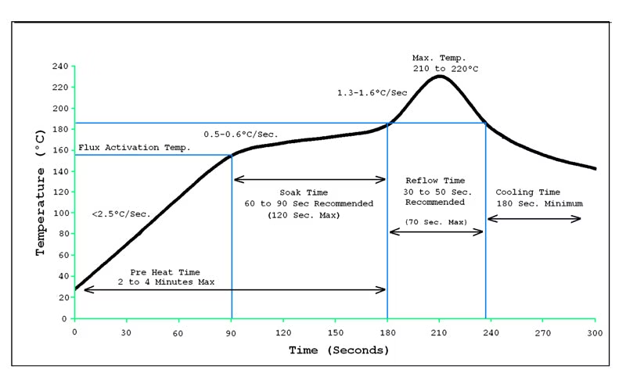
Temperature vs Time Curve
Reflow Profile Phases
Key Details
Preheat: gradual temperature rise
Setpoint updates every 5 seconds
Soak: temperature stabilization
Follows industry-standard thermal curve
Reflow: peak temperature for soldering
Maintains temperature with minimal overshoot
Cooling: controlled temperature decrease

Slide 4
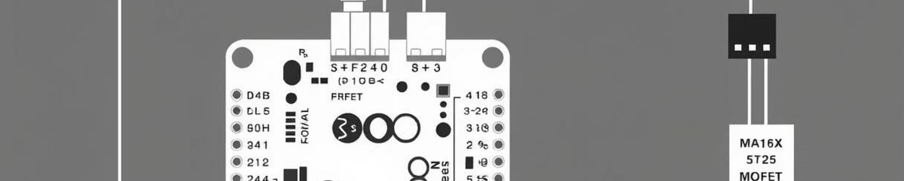
System Overview
PID Temperature Control
Temperature Sensing
Accurately maintains profile setpoints
MAX6675 thermocouple amplifier via SPI
Actuation
Data & UI
Heater/fan driven with PWM and MOSFETs
LCD output and UART streaming to PC

Slide 5
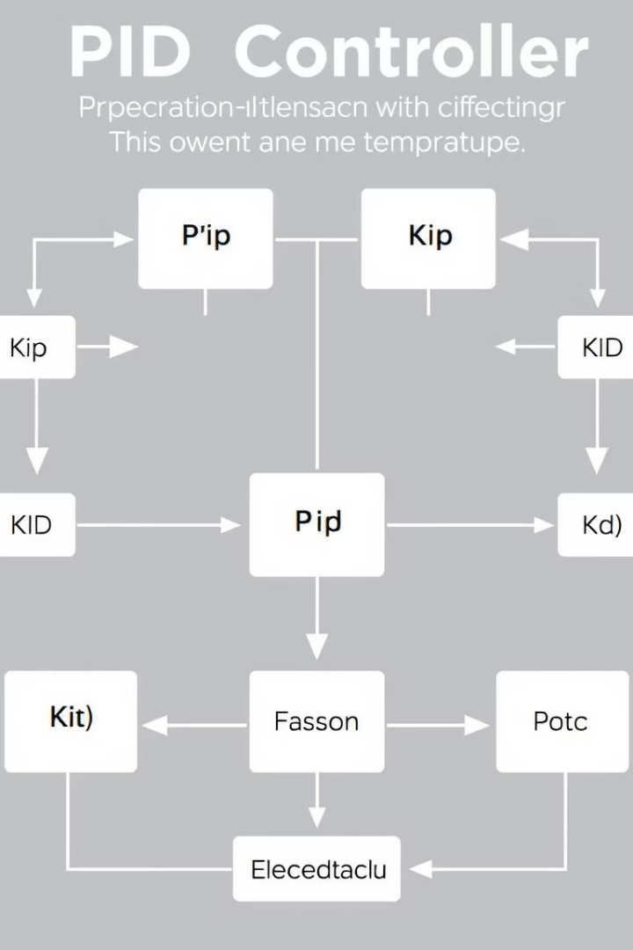
PID Control Logic
Error Calculation
Difference between setpoint and current temperature
PID Terms
Proportional: immediate response
Integral: corrects cumulative error
Derivative: predicts trend
Output
PWM scaled to 8-bit, drives heater or fan
Direction
Positive error activates heater, negative activates fan

Slide 6
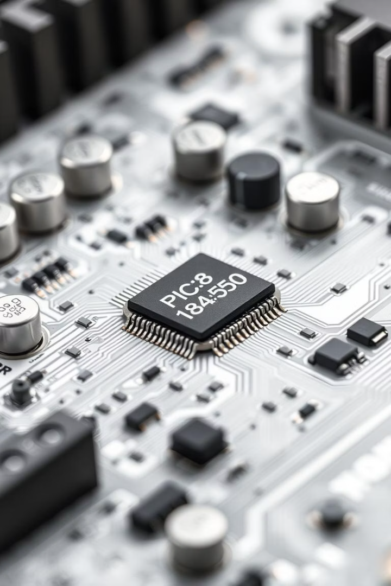




Hardware Components
PIC18F4550
MAX6675
IRF450N MOSFETs
Thermocouple amplifier and ADC
Main microcontroller for control
Switch heater & fan loads
16x2 LCD
User interface display

Slide 7
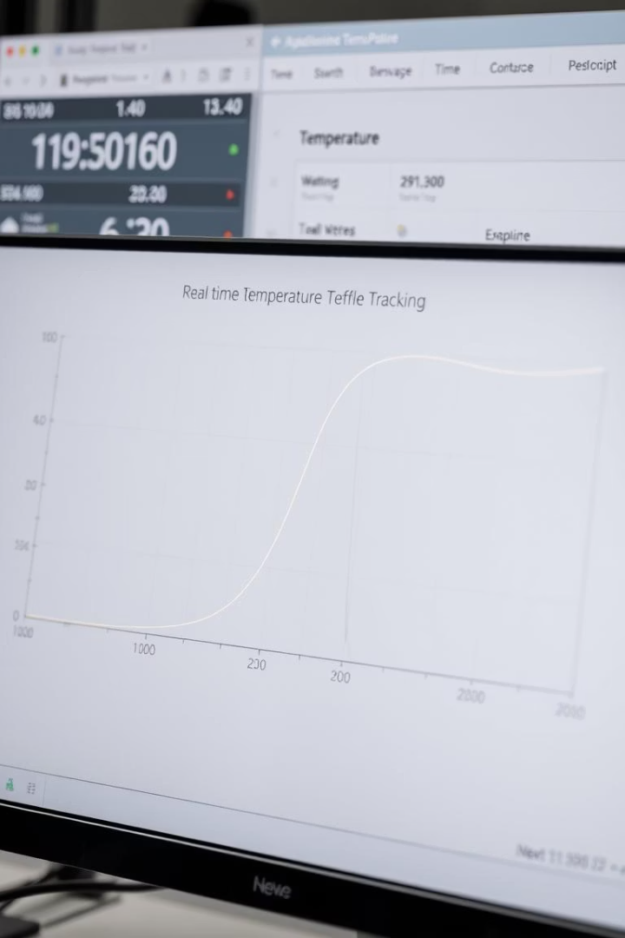
Results Summary
Temperature Tracking
Low overshoot, accurate profile adherence
Smooth PID Adjustment
Effective PWM modulation for control
Real-time Visualization
Data streamed live via UART to PC
Validation
Verified in Proteus simulation and hardware

